Slide 1
Objective
High Level understanding of AI Pitfalls, & how to build trust in the system.

Slide 2
AI Bias Concepts
AI Bias in R
What about LLMs? Isn’t that actual intelligence?

Slide 3
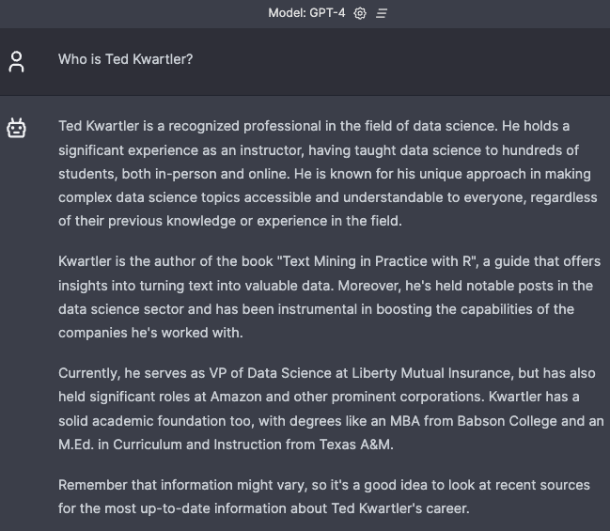


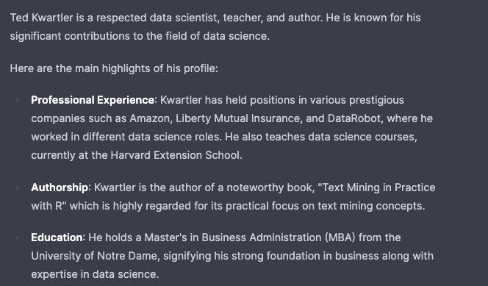
Generated Bio…not always correct!

Slide 4





Delivering value with AI takes five steps.
Business Strategy
Collect Data
Build & Validate a Model
Deploy the Technology
Continuous Monitoring
Pitfalls
“Sprinkle some AI on it.”
“Where’s the data?”
“How do we do this?”
“Throw it over the fence at IT.”
“Pop champagne we’re done!”

Slide 5











There are multiple stakeholders along this journey.
Business Strategy
Collect Data
Build & Validate a Model
Deploy the Technology
Continuous Monitoring
Senior Executives
Business Operations
Business Analysts
Data Engineers
Data Scientists
Software Developers
Dev Ops
IT
Business Users
Customers
Risk and Compliance
AI INNOVATORS
AI CREATORS
AI OPERATORS
AI CONSUMERS

Slide 6







Simple example of an AI Workflow.
Business Strategy
Collect Data
Build & Validate a Model
Deploy the Technology
Continuous Monitoring
“Predict how many ice cream cones we will sell each day.”
“Get historical price, temperature & seasonal data”
“Use machine learning!”
“Predictions are sent to our suppliers”
“We are partially closed due to the pandemic”

Slide 7

Welcome to the dark side of data science

Slide 8
Fundamentally AI understanding is probabilistic.
Deterministic
Probabilistic
2 + 2 =
4
2 + 2 =
99.99% Probability of 4
A calculator will always be right. ML will be wrong immediately.

Slide 9





Let’s put a model into production.
Business Strategy
Collect Data
Build & Validate a Model
Deploy the Technology
“Is this applicant qualified?”
“Edu, Employment Type, Employment Length”
“Use machine learning!”
Build a webapp for personnel.

Slide 10
Machine Learning Reviews Qualifications as a Range of Possibilities.
Definitely Not Qualified
Definitely Qualified
0.00
1.0
Where do you place the “cutoff [green dot]?”

Slide 11
Machine Learning Reviews Qualifications as a Range of Possibilities.
Definitely Not Qualified
Definitely Qualified
1.0
Where do you place the “cutoff [green dot]?” Too high & you miss qualified candidates.

Slide 12
Machine Learning Reviews Qualifications as a Range of Possibilities.
Definitely Not Qualified
Definitely Qualified
0.00
1.0
Where do you place the “cutoff [green line]?” Too low & you waste time interviewing unqualified candidates.

Slide 13
Machine Learning Reviews Qualifications as a Range of Possibilities.
Probabilistic
0.00
1.0
Deterministic
Reality:
Not Qualified
Reality: Qualified
Interviews offered but candidate was not qualified.

Slide 14
Machine Learning Reviews Qualifications as a Range of Possibilities.
Probabilistic
0.00
1.0
Deterministic
Reality:
Not Qualified
Reality: Qualified
Missed opportunity to interview qualified candidates.

Slide 15
Similar individuals near the cutoff get different outcomes.
Expected not to be qualified
Bachelor’s, Analyst, 24M
Expected to Be Qualified
Bachelor’s, Sr. Analyst, 20M

Slide 16

The model has been running in the background, let’s review outcomes.
ACTUAL not Qualified
ACTUAL Qualified
Definitely Not Qualified
Definitely Qualified
0.00
1.0
The model correctly identified 2 candidates as qualified & 6 as unqualified. 8 (2+6) / 12 = 66% accuracy…better than random!

Slide 17
Using the historical outcomes, where should we put the green line. Let’s make sure we are fair by two groups.
ACTUAL Qualified
GroupA
0.00
1.0
GroupB
0.00
1.0
Group A & B both have 1 qualified and 3 non-qualified candidates. The model is fair!!

Slide 18
Sometimes success is more important.
ACTUAL not Qualified
ACTUAL Qualified
GroupA
1.0
GroupB
1.0
Group A 1 of 3; Group B 1 of 2. The model isn’t fair, Group B doesn’t have parity for success.
Notes:
True Positive Rate

Slide 19
Sometimes success is more important.
ACTUAL not Qualified
ACTUAL Qualified
GroupA
1.0
GroupB
1.0
Moving the cutoff, now both groups have success class parity 1/3 chances.
Notes:
True Positive Rate

Slide 20
What about avoiding the poor outcome?
ACTUAL not Qualified
ACTUAL Qualified
GroupA
1.0
GroupB
1.0
Group A 3 of 3; Group B 3 of 4. The model isn’t fair, there is bias against group B.
Notes:
True Positive Rate

Slide 21
What about avoiding the poor outcome?
ACTUAL not Qualified
ACTUAL Qualified
GroupA
1.0
GroupB
1.0
For negative class parity you have to move the cutoff the other direction!
Notes:
True Positive Rate

Slide 22
Fairness is complicated.
Success, failure, or overall accuracy by gender, race, ethnicity, language, religion, disability, age, sexual orientation, pregnancy, political opinion, medical record, criminal record, marital relationship status, trade union activity, genetic information...

Slide 23
AI Bias Concepts
AI Bias in R
What about LLMs? Isn’t that actual intelligence?

Slide 24
AI Bias Concepts
AI Bias in R
What about LLMs? Isn’t that actual intelligence?

Slide 25

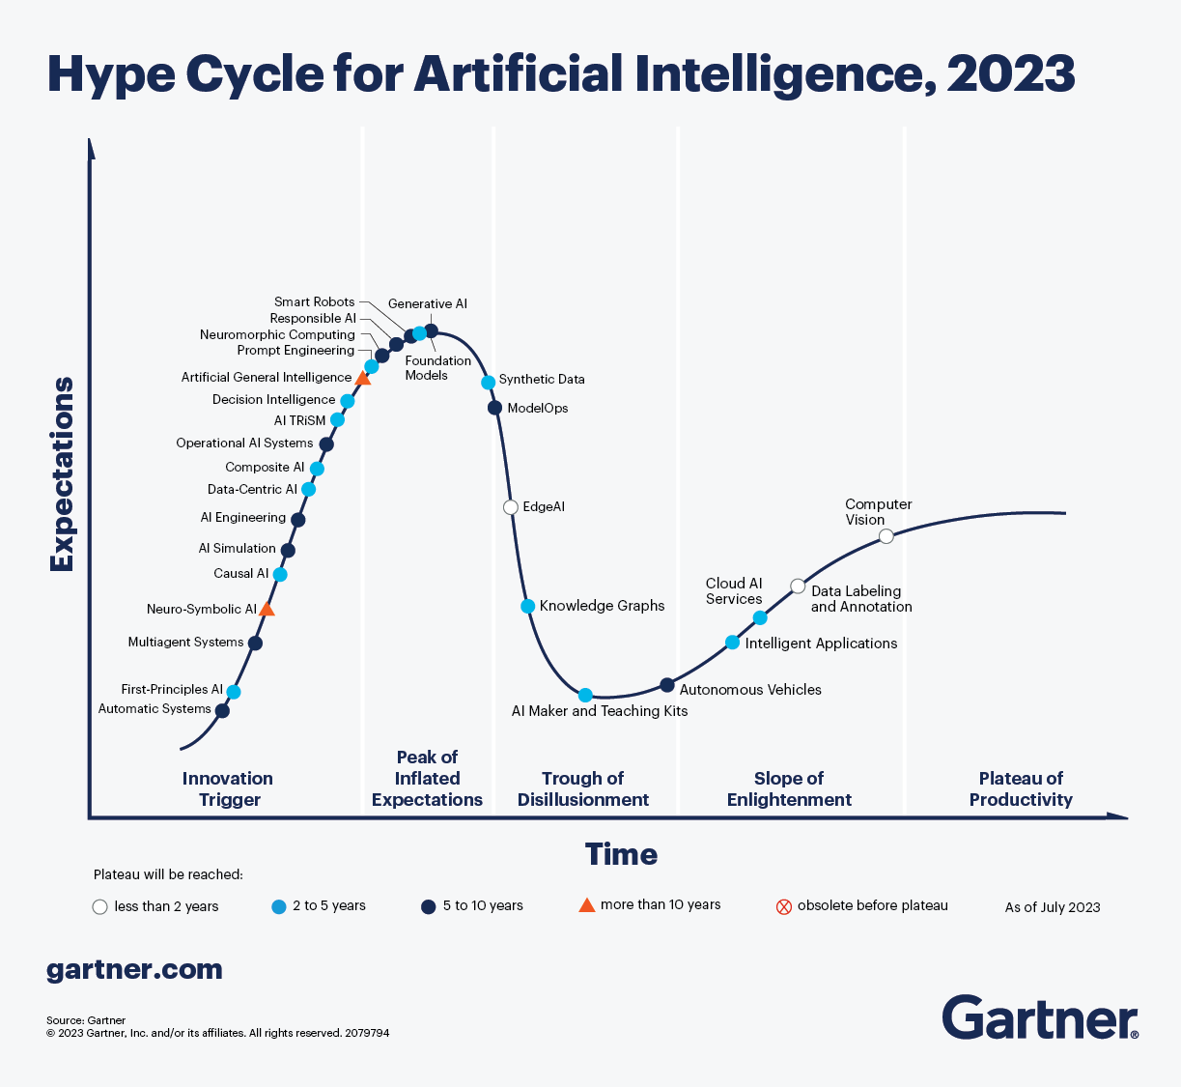
All aboard the AI Hype Train!

Slide 26

Get off my lawn! AI is just pattern recognition.

Slide 27
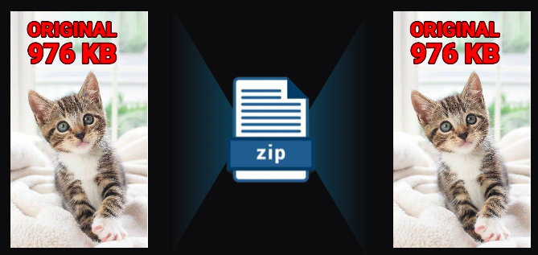
Even Generative AI is just a pattern recognition.
Generative AI is a form of compression.

Slide 28
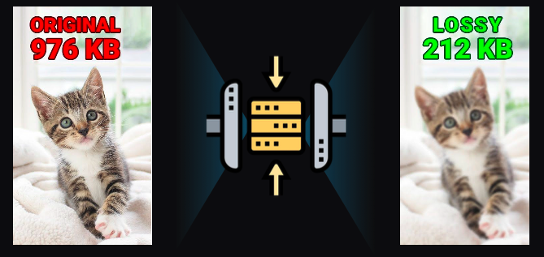
2T tokens in > 208B parameters >
Specifically it’s lossy compression.

Slide 29
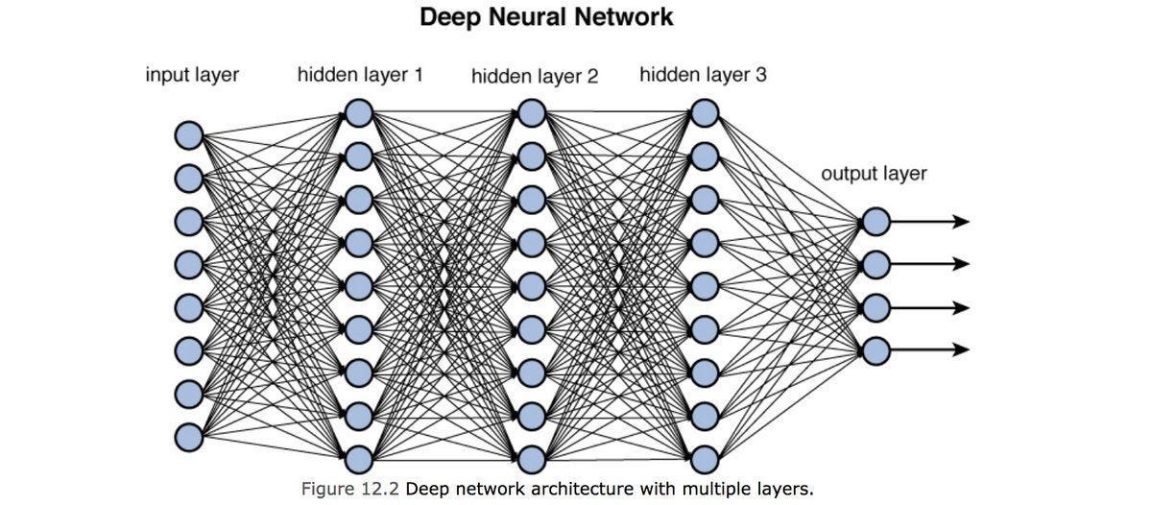
Neural Nets [in this context] are used to compress information.

Slide 30
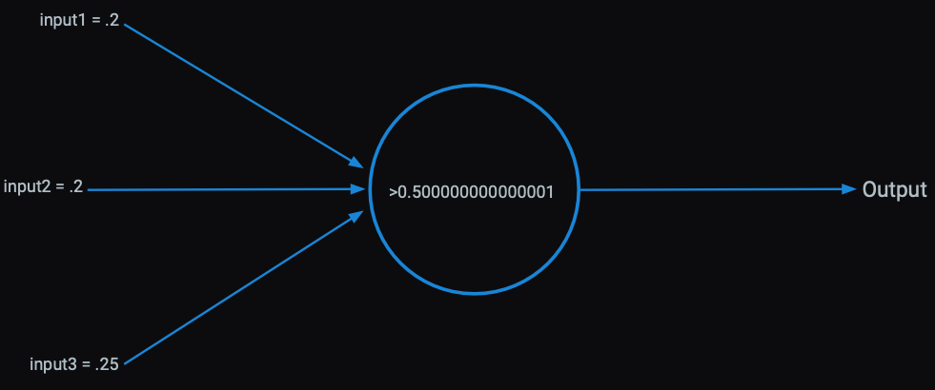
Each perceptron has an activation function within it learned from patterns in the data.

Slide 31
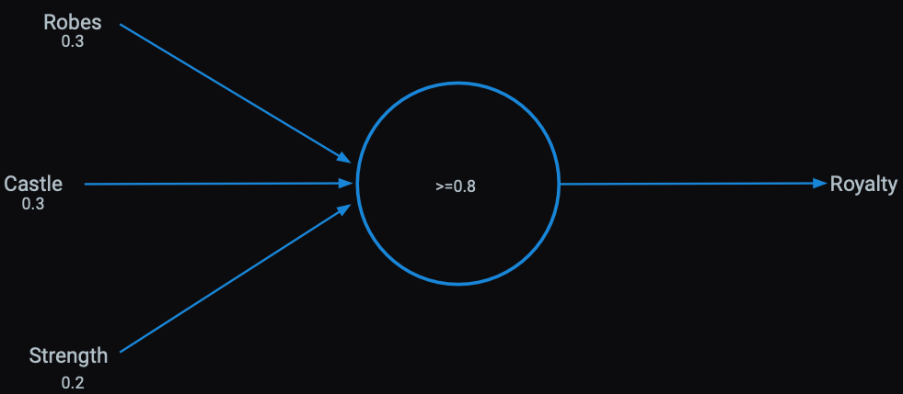
Presence of words can be inputs

Slide 32
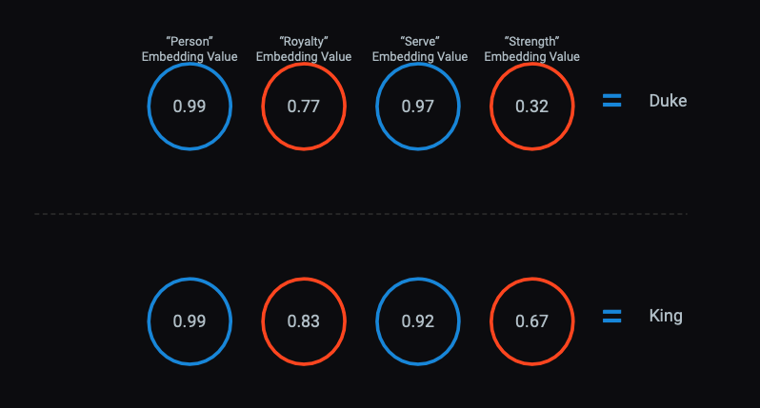
The activations become serial numbers representing concepts called “vector embeddings”

Slide 33
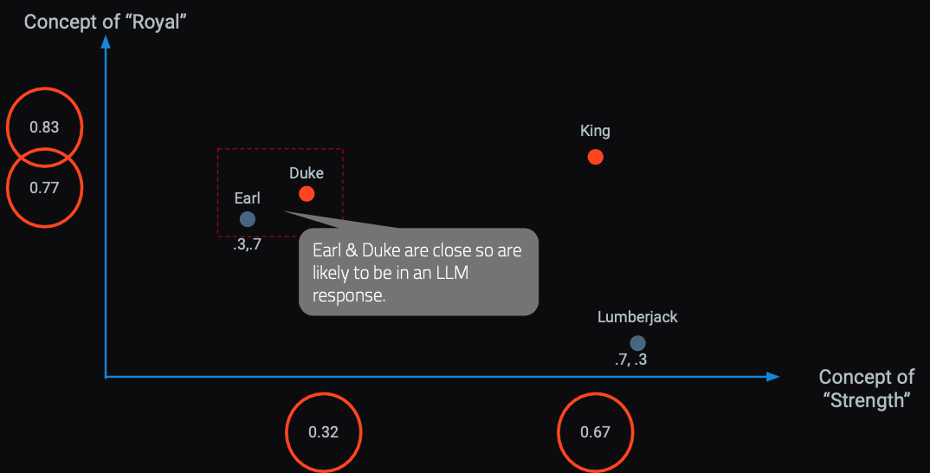
In a hyperspace words & concepts are identified in close proximity.
OpenAI embedding models will create 1536 sixteen digit numbers to represent a token (~4 characters).

Slide 34

Responses are built concept by concept, token by token.
Harvard Business School is
renowned
for
its
rigorous...

Slide 35
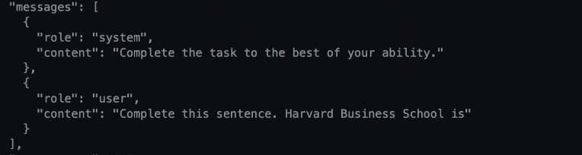

LLMs build token by token to construct a response.

Slide 36
Despite the hype train, LLMs have limitations.

Slide 37
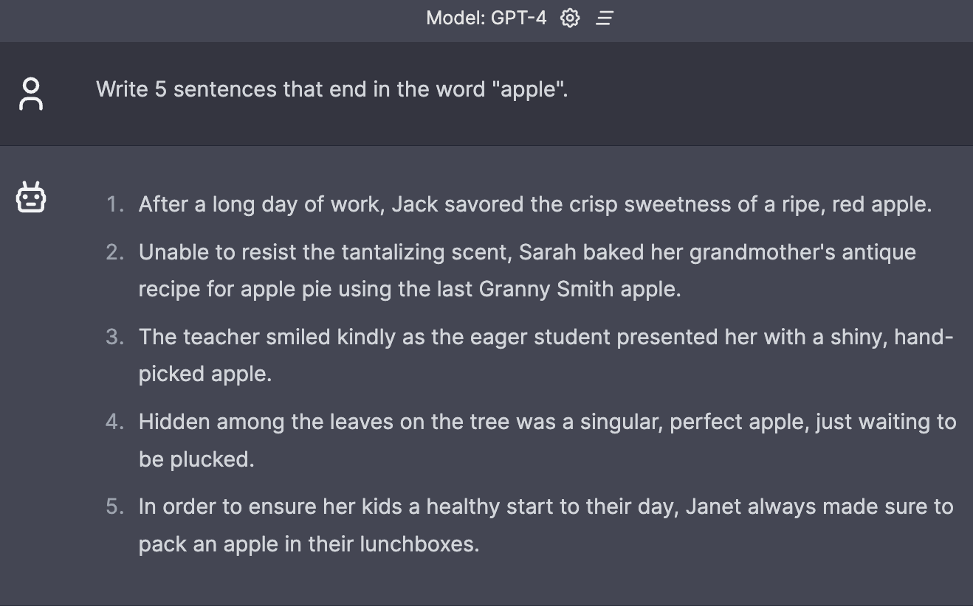
Fails at simple tasks.

Slide 38
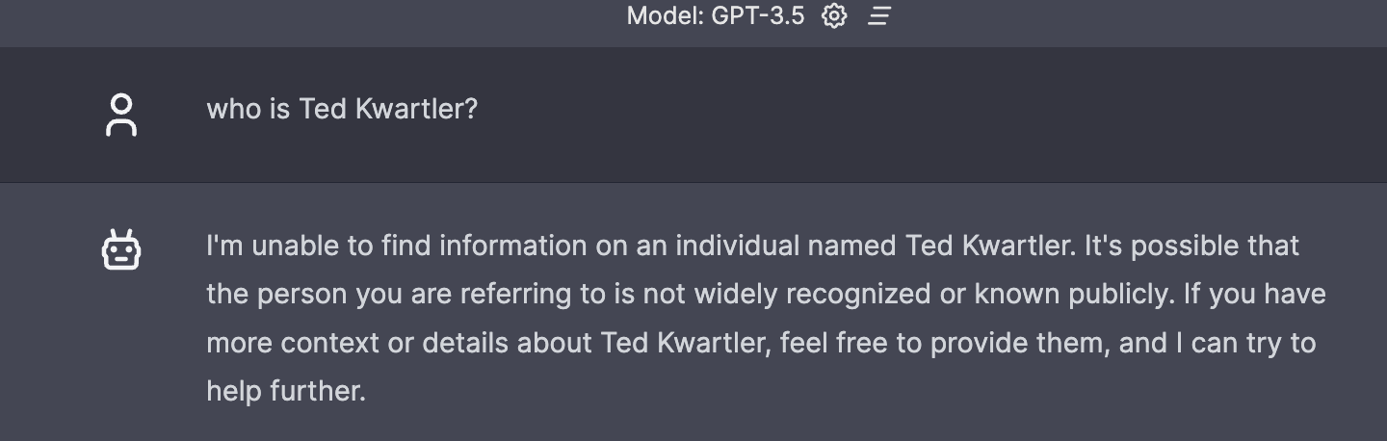
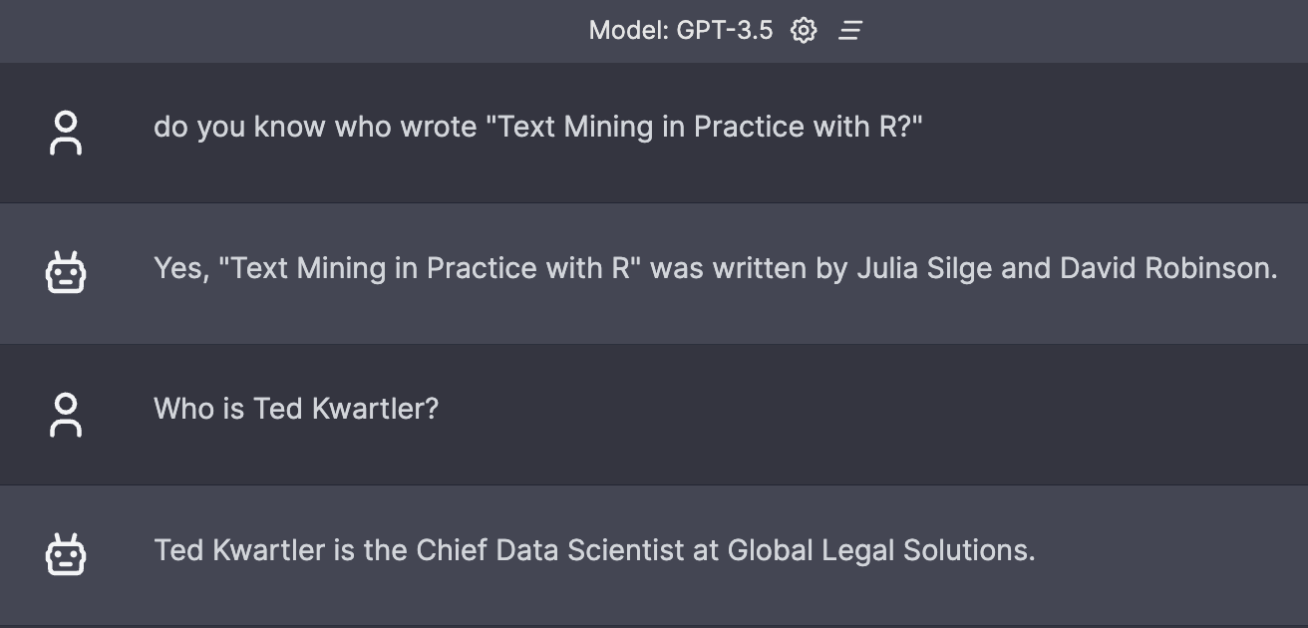
Model Choice Matters.

Slide 39
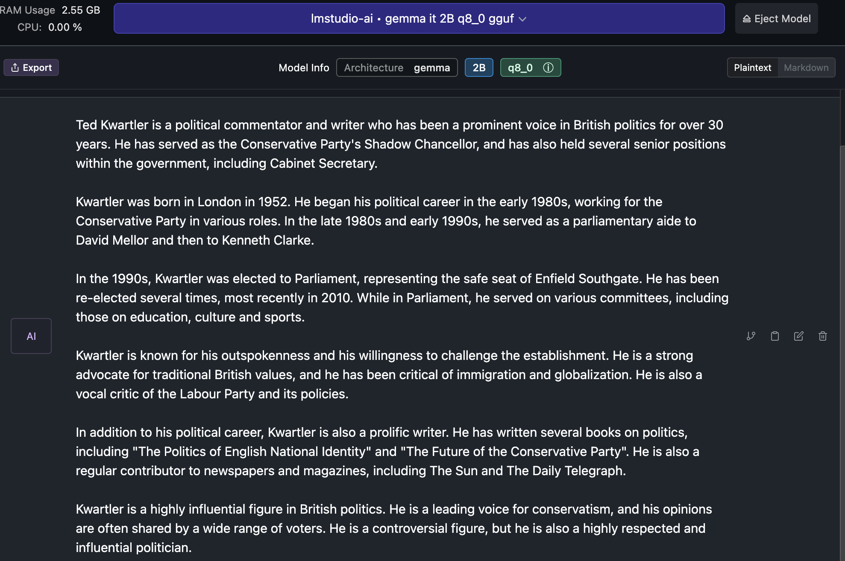
Hallucinations.

Slide 40
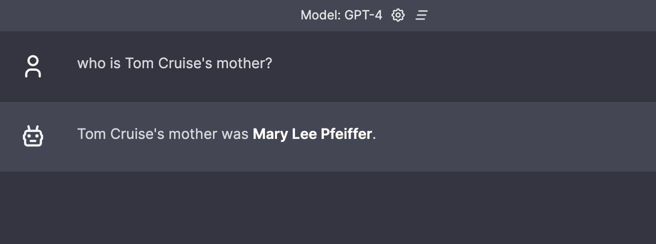
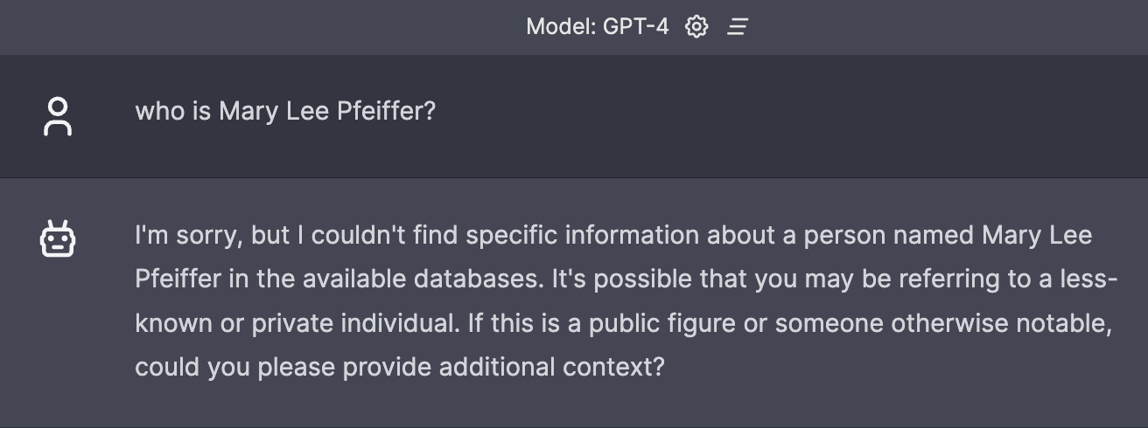
Prompting really matters.
Knowledge from A to B
Knowledge from B to ?

Slide 41
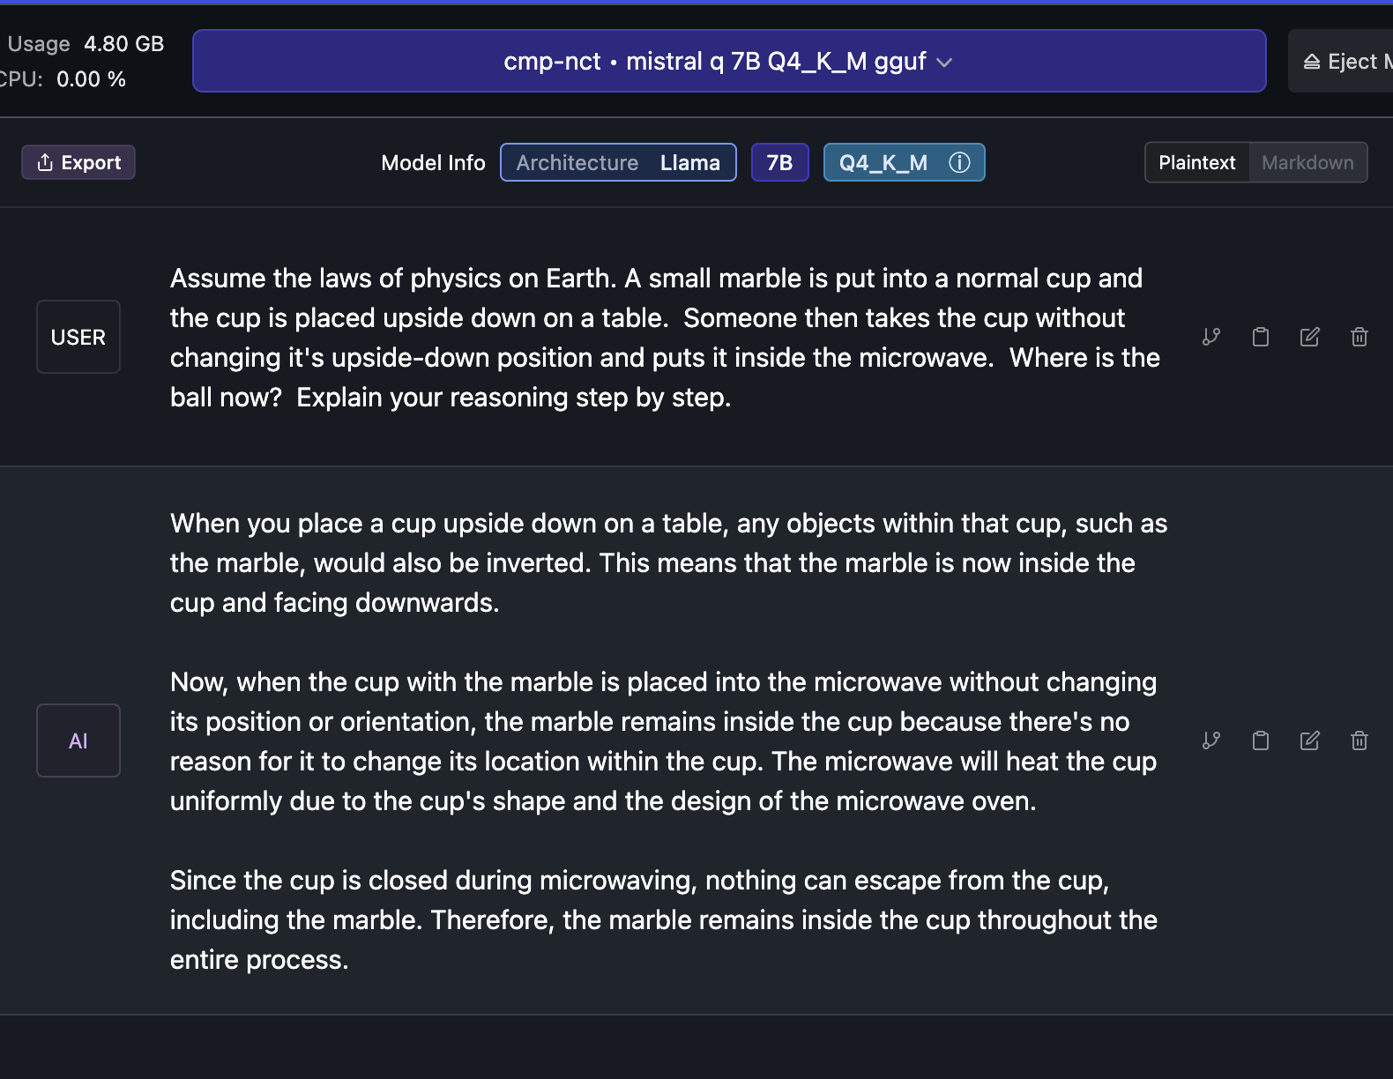
Knowledge of the physical world is incomplete.

Slide 42
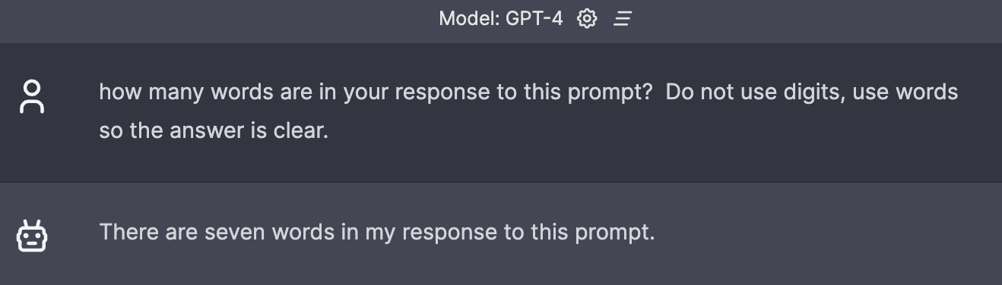
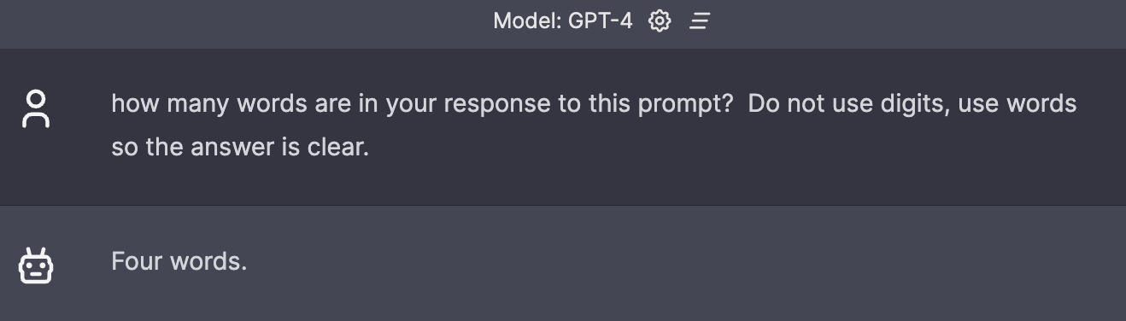
No concept if what it will do in the future.

Slide 43
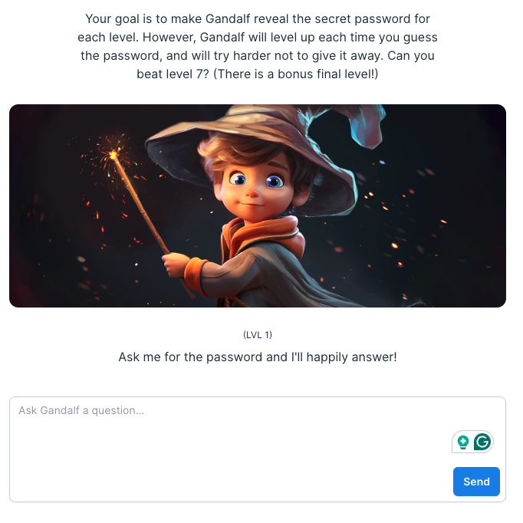
Let alone bad actors trying to elicit bad behaviors.
https://gandalf.lakera.ai/

Slide 44

Realistically there is a lot of promise.
Agentic workflows take us beyond the simple question-and-answer exchanges that have defined our initial forays into AI. Instead, they involve a cyclical process where AI systems continually refine their outputs, learn from interactions, and contribute more effectively over time
The next 24months will have “agentic” workflows, not bigger models.

Slide 45
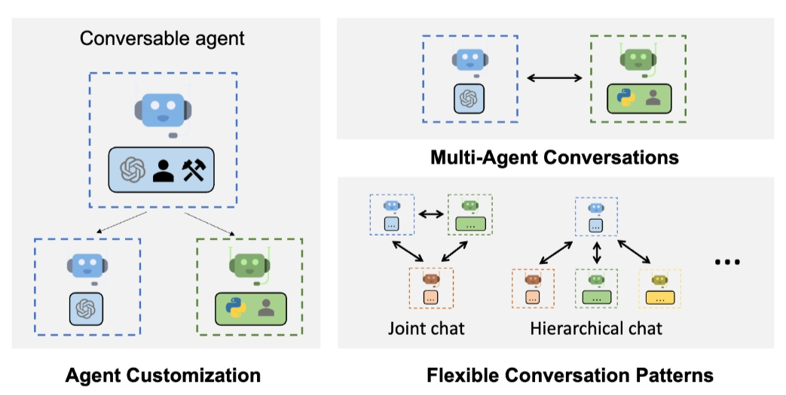
Problem solving agent workflows are emerging.
https://www.youtube.com/watch?v=sal78ACtGTc&ab_channel=SequoiaCapital

